Slide 1
Apache Spark – DataFrames
Atul Kahate

Slide 2
DataFrame Basics
If you’ve worked with pandas in Python, R, SQL or even Excel, a DataFrame will feel very familiar.
Spark DataFrames hold data in a column and row format.
Each column represents some feature or variable.
Each row represents an individual data point.
Spark began with something known as the “RDD” syntax which was a little ugly and tricky to learn.
Now Spark 2.0 and higher has shifted towards a DataFrame syntax which is much cleaner and easier to work with!

Slide 3
DataFrame Usage
Spark DataFrames are able to input and output data from a wide variety of sources.
We can then use these DataFrames to apply various transformations on the data.
At the end of the transformation calls, we can either show or collect the results to display or for some final processing.

Slide 4
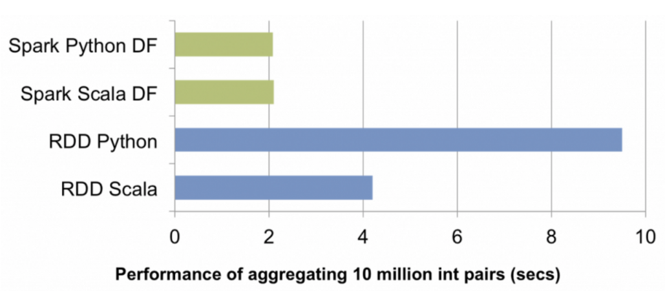
Performance: RDD versus DataFrames
With RDD, Scala was much better than other languages, but with DF, this difference has gone away

Slide 5
DataFrame Hands-on

Slide 6
Creating a DataFrame …
First, create a Spark session
from pyspark.sql import SparkSession
spark = SparkSession.builder.appName(‘Basics’).getOrCreate()
Read the input file
df = spark.read.json(‘people.json’)
Display the results
df.show()

Slide 7
C:\code\spark\cdac\df\1-df.py
from pyspark.sql import SparkSession
spark = SparkSession.builder.appName(‘Basics’).getOrCreate()
df = spark.read.json(‘people.json’)
df.show()
To see the dataset schema: df.printSchema()
To see the columns: print(df.columns)
To see a statistical summary: df.describe().show()
To see column names with types: print (df.describe) … Note that age is also shown as a string column … How to fix? Follows shortly

Slide 8
C:\code\spark\cdac\df\people.json
{"name":“Warren"}
{"name":“Charlie", "age":30}
{"name":"Justin", "age":19}

Slide 9
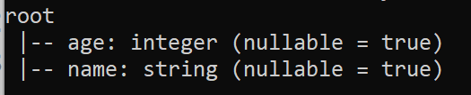
Fixing Schema Issues (C:\code\spark\cdac\df\2-df.py)
We can provide our own schema to avoid misinterpretation
from pyspark.sql.types import StructField, StringType, IntegerType, StructType
from pyspark.sql import SparkSession
spark = SparkSession.builder.appName('Basics').getOrCreate()
# Third parameter indicates nulls allowed?
data_schema = [StructField ('age', IntegerType(), True),
StructField ('name', StringType(), True)]
final_struct = StructType (fields = data_schema)
df = spark.read.json ('people.json', schema = final_struct)
df.printSchema ()

Slide 10
Reading a CSV file (C:\code\spark\cdac\df\3-df.py)
from pyspark.sql import SparkSession
spark = SparkSession.builder.appName('Basics').getOrCreate()
df = spark.read.csv ('appl_stock.csv', inferSchema = True, header = True)
df.printSchema ()
df.filter ("Close < 500").show()
df.filter ("Close < 500").select (['Open', 'Close']).show()

Slide 11
Multiple Conditions (C:\code\spark\cdac\df\4-df.py)
from pyspark.sql import SparkSession
spark = SparkSession.builder.appName('Basics').getOrCreate()
df = spark.read.csv ('appl_stock.csv', inferSchema = True, header = True)
# A slightly different syntax is considered better, so we will use it
# df.filter ("Close < 500").select (['Open', 'Close']).show()
df.filter ( (df ['Close'] < 500) & (df ['Open'] > 200)).show()

Slide 12
Getting results into a variable (C:\code\spark\cdac\df\5-df.py)
from pyspark.sql import SparkSession
spark = SparkSession.builder.appName('Basics').getOrCreate()
df = spark.read.csv ('appl_stock.csv', inferSchema = True, header = True)
# collect () will store the results into a Python List
filtered = df.filter (df ['Low'] == 197.16).collect ()
print (filtered)

Slide 13
GroupBy and Aggregate (C:\code\spark\cdac\df\6-df.py)
from pyspark.sql import SparkSession
spark = SparkSession.builder.appName('Basics').getOrCreate()
df = spark.read.csv ('sales_info.csv', inferSchema = True, header = True)
df.groupBy ("Company").mean ().show ()
df.groupBy ("Company").sum ().show ()
df.groupBy ("Company").min ().show ()
df.groupBy ("Company").max ().show ()
df.groupBy ("Company").count ().show ()

Slide 14
Overall Aggregate (C:\code\spark\cdac\df\7-df.py)
from pyspark.sql import SparkSession
spark = SparkSession.builder.appName('Basics').getOrCreate()
df = spark.read.csv ('sales_info.csv', inferSchema = True, header = True)
df.agg ({'Sales': 'sum'}).show ()
df.agg ({'Sales': 'min'}).show ()
df.agg ({'Sales': 'max'}).show ()
df.agg ({'Sales': 'count'}).show ()
df.agg ({'Sales': 'mean'}).show ()

Slide 15
Aggregate – Combining Syntaxes (C:\code\spark\cdac\df\8-df.py)
from pyspark.sql import SparkSession
spark = SparkSession.builder.appName('Basics').getOrCreate()
df = spark.read.csv ('sales_info.csv', inferSchema = True, header = True)
group_data = df.groupBy ('Company')
group_data.agg ({'Sales': 'sum'}).show ()

Slide 16
Overall Aggregate – Using Spark Functions (C:\code\spark\cdac\df\9-df.py)
from pyspark.sql import SparkSession
from pyspark.sql.functions import countDistinct, avg
spark = SparkSession.builder.appName('Basics').getOrCreate()
df = spark.read.csv ('sales_info.csv', inferSchema = True, header = True)
df.select (countDistinct ('Sales')). show ()
df.select (avg ('Sales')). show ()

Slide 17
Formatting Output (C:\code\spark\cdac\df\10-df.py)
from pyspark.sql import SparkSession
from pyspark.sql.functions import avg, format_number
spark = SparkSession.builder.appName('Basics').getOrCreate()
df = spark.read.csv ('sales_info.csv', inferSchema = True, header = True)
sales_avg = df.select (avg ('Sales'). alias ('std'))
sales_avg.select (format_number ('std', 2). alias ('Average')). show ()

Slide 18
Ordering Output (C:\code\spark\cdac\df\11-df.py)
from pyspark.sql import SparkSession
spark = SparkSession.builder.appName('Basics').getOrCreate()
df = spark.read.csv ('sales_info.csv', inferSchema = True, header = True)
df.orderBy ("Sales"). show ()
df.orderBy (df["Sales"].desc ()). show ()

Slide 19
Missing Data (C:\code\spark\cdac\df\12-df.py)
from pyspark.sql import SparkSession
spark = SparkSession.builder.appName('Missing').getOrCreate()
df = spark.read.csv ('containsNull.csv', inferSchema = True, header = True)
df.show ()
# Drop rows that have any null value columns
df.na. drop (). show ()
# A row must have at least two non-null columns to be appear in the output
df.na.drop (thresh = 2). show ()
# Drop rows that have any null value columns
df.na.drop (how = 'any'). show ()
# Drop rows that have all null value columns
df.na.drop (how = 'all'). show ()
# Drop rows that have a null value in the Sales column
df.na.drop (subset = ['Sales']). show ()
# Fill null values with our own value
df.na.fill ('DUMMY INSERT'). show ()
# Fill null values with zeroes for numeric columns
df.na.fill (0). show ()
# Fill null values only for name column with our own value
df.na.fill ('No name', subset = ['Name']). show ()

Slide 20
Fill Missing Data with Averages (C:\code\spark\cdac\df\13-df.py)
from pyspark.sql import SparkSession
from pyspark.sql.functions import mean
spark = SparkSession.builder.appName('Missing').getOrCreate()
df = spark.read.csv ('containsNull.csv', inferSchema = True, header = True)
mean_value = df.select (mean (df ['Sales'])).collect ()
# The following print statements are just to show how to extract the actual value
# of the variable mean_value
print (mean_value)
print (mean_value [0][0])
mean_sales = mean_value [0][0]
df.na.fill (mean_sales, ['Sales']).show ()
# Same thing, cryptic syntax
df.na.fill (df.select (mean (df ['Sales'])).collect () [0][0], ['Sales']). show ()

Slide 21
Working with Dates and Times (C:\code\spark\cdac\df\14-df.py)
from pyspark.sql import SparkSession
from pyspark.sql.functions import mean
spark = SparkSession.builder.appName('Missing').getOrCreate()
df = spark.read.csv ('containsNull.csv', inferSchema = True, header = True)
mean_value = df.select (mean (df ['Sales'])).collect ()
# The following print statements are just to show how to extract the actual value
# of the variable mean_value
print (mean_value)
print (mean_value [0][0])
mean_sales = mean_value [0][0]
df.na.fill (mean_sales, ['Sales']).show ()
# Same thing, cryptic syntax
df.na.fill (df.select (mean (df ['Sales'])).collect () [0][0], ['Sales']). show ()

Slide 22
Joins (C:\code\spark\cdac\df\15-df.py)
from pyspark.sql import SparkSession
spark = SparkSession.builder.appName('Basics').getOrCreate()
empDF = spark.read.csv ('emp.csv', inferSchema = True, header = True)
deptDF = spark.read.csv ('dept.csv', inferSchema = True, header = True)
#empDF.printSchema()
empDF.join (deptDF, empDF.emp_dept_id == deptDF.dept_id, "inner").show()
empDF.join (deptDF, empDF.emp_dept_id == deptDF.dept_id, "outer").show()
empDF.join (deptDF, empDF.emp_dept_id == deptDF.dept_id, "full").show()
empDF.join (deptDF, empDF.emp_dept_id == deptDF.dept_id, "fullouter").show()
empDF.join (deptDF, empDF.emp_dept_id == deptDF.dept_id, "left").show()
empDF.join (deptDF, empDF.emp_dept_id == deptDF.dept_id, "leftouter").show()
empDF.join (deptDF, empDF.emp_dept_id == deptDF.dept_id, "right").show()
empDF.join (deptDF, empDF.emp_dept_id == deptDF.dept_id, "rightouter").show()

Slide 23
Joins - Dataset (C:\code\spark\cdac\df\emp.csv)
emp_id,name,supervisor_emp_id,year_joined,emp_dept_id,gender,salary
1,Smith,-1,2018,10,M,3000
2,Rose,1,2010,20,M,4000
3,Williams,1,2010,10,M,1000
4,Jones,2,2005,10,F,2000
5,Brown,2,2010,40,,-1
6,Brown,2,2010,50,,-1

Slide 24
Joins - Dataset (C:\code\spark\cdac\df\dept.csv)
dept_name,dept_id
Finance, 10
Marketing, 20
Sales, 30
IT, 40

Slide 25
DataFrame Exercise
Use walmart_stock.csv file to answer the questions below.
Create a new dataframe with a column called HV Ratio, which is the ratio of the High Price versus volume of stock traded everyday.
What day had the peak high in price?
What is the average of the Close column?
What is the maximum and minimum of volume?
How many days was the Close lower than 60 dollars?
What percentage of the time was the High greater than 80 dollars?
What is the maximum High per year?
What is the average Close for each calendar month?

Slide 26
DataFrame Exercise – Solutions
Create a new dataframe with a column called HV Ratio, which is the ratio of the High Price versus volume of stock traded everyday.
df2 = df.withColumn("HV Ratio",df["High"]/df["Volume"])#.show()
# df2.show()
df2.select('HV Ratio').show()
2. What day had the peak high in price?
df.orderBy(df["High"].desc()).head(1)[0][0]
3. What is the average of the Close column?
from pyspark.sql.functions import mean
df.select(mean("Close")).show()
4. What is the maximum and minimum of volume?
from pyspark.sql.functions import max,min
df.select(max("Volume"),min("Volume")).show()

Slide 27
DataFrame Exercise – Solutions
How many days was the Close lower than 60 dollars?
df.filter("Close < 60").count() OR
df.filter(df['Close'] < 60).count() OR
from pyspark.sql.functions import count
result = df.filter(df['Close'] < 60)
result.select(count('Close')).show()
6. What percentage of the time was the High greater than 80 dollars?
(df.filter(df["High"]>80).count()*1.0/df.count())*100
What is the maximum High per year?
What is the average Close for each calendar month?

Slide 28
DataFrame Exercise – Solutions
7. What is the maximum High per year?
from pyspark.sql.functions import year
yeardf = df.withColumn("Year",year(df["Date"]))
max_df = yeardf.groupBy('Year').max()
max_df.select('Year','max(High)').show()
8. What is the average Close for each calendar month?
from pyspark.sql.functions import month
monthdf = df.withColumn("Month",month("Date"))
monthavgs = monthdf.select("Month","Close").groupBy("Month").mean()
monthavgs.select("Month","avg(Close)").orderBy('Month').show()

Slide 29
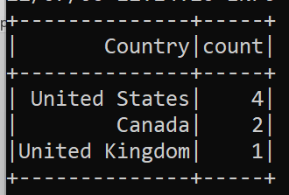
SparkSQL (C:\code\spark\cdac\df\spark-sql-1.py)
import sys
from pyspark.sql import SparkSession
if __name__ == "__main__":
spark = SparkSession \
.builder \
.master("local[3]") \
.appName("HelloSparkSQL") \
.getOrCreate()
surveyDF = spark.read \
.option("header", "true") \
.option("inferSchema", "true") \
.csv("sample.csv")
surveyDF.createOrReplaceTempView("survey_tbl")
countDF = spark.sql("select Country, count(1) as count from survey_tbl where Age<40 group by Country")
countDF.show()

Slide 30
C:\code\spark\cdac\df\spark-sql-2.py
from pyspark.sql import SparkSession
spark = SparkSession.builder.appName('spark sql').getOrCreate()
data = [("James","M",60000),("Michael","M",70000),
("Robert",None,400000),("Maria","F",500000),
("Jen","",None)]
columns = ["name","gender","salary"]
df = spark.createDataFrame(data = data, schema = columns)
df.show()

Slide 31
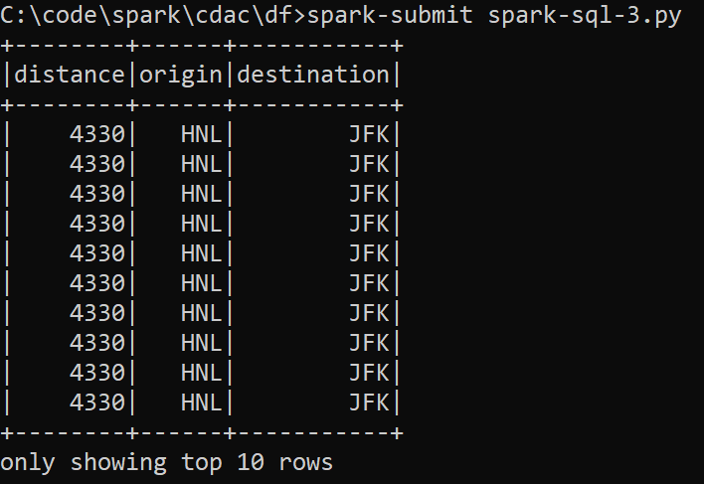
C:\code\spark\cdac\df\spark-sql-3.py (Download dataset: https://raw.githubusercontent.com/databricks/LearningSparkV2/master/databricks-datasets/learning-spark-v2/flights/departuredelays.csv)
ffrom pyspark.sql import SparkSession
spark = (SparkSession
.builder
.appName("SparkSQLExample")
.getOrCreate())
csv_file = "departuredelays.csv"
schema = "`date` STRING `delay` INT, `distance` INT, `origin` STRING, `destination` STRING"
df = (spark.read.format("csv")
.option("inferSchema", "false")
.option("header", "true")
.schema(schema)
.load(csv_file))
df.createOrReplaceTempView("us_delay_flights_tbl")
spark.sql("""SELECT distance, origin, destination
FROM us_delay_flights_tbl
WHERE distance > 1000
ORDER BY distance DESC""").show(10)
# Now the same result using data frame
from pyspark.sql.functions import col, desc
(df.select ("distance", "origin", "destination")
.where (col ("distance") > 1000)
.orderBy (desc ("distance"))).show (10)
# Another syntax
(df.select ("distance", "origin", "destination")
.where ("distance > 1000")
.orderBy ("distance", ascending = False).show (10))

Slide 32
Problem statement
For the same dataset, find all the flights between San Francisco (SFO) and Chicago (ORD) with at least a two-hour delay

Slide 33
C:\code\spark\cdac\df\spark-sql-4.py
from pyspark.sql import SparkSession
spark = (SparkSession
.builder
.appName("SparkSQLExample")
.getOrCreate())
csv_file = "departuredelays.csv"
schema = "`date` STRING, `delay` INT, `distance` INT, `origin` STRING, `destination` STRING"
df = (spark.read.format("csv")
.option("inferSchema", "false")
.option("header", "true")
.schema(schema)
.load(csv_file))
df.createOrReplaceTempView("us_delay_flights_tbl")
spark.sql("""SELECT date, delay, origin, destination
FROM us_delay_flights_tbl
WHERE delay > 120 AND origin = 'SFO' AND destination = 'ORD'
ORDER BY delay DESC""").show(10)

Slide 34
Spark SQL – Databases and Tables

Slide 35
Databases and Tables
Spark allows us to work with SQL-like syntax, for which it needs to create databases and tables
Instead of creating a separate metastore for Spark tables, Spark by default uses the Apache Hive metastore
Spark allows two types of tables:
Managed tables: Spark manages metadata and data
DROP table will cause deletion of metadata and data
Unmanaged tables: Spark manages only the metadata, the users manage the data in an external data source, such as Cassandra
DROP table will cause deletion of only metadata

Slide 36
Creating a Database
In Spark shell (pyspark):
spark.sql (“CREATE DATABASE learn_spark_db”)
spark.sql (“USE learn_spark_db)
Now, any commands we issue in our application to create tables will result in the tables being created in this database and residing under the database name learn_spark_db

Slide 37
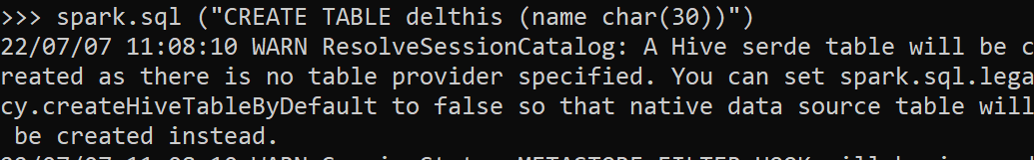
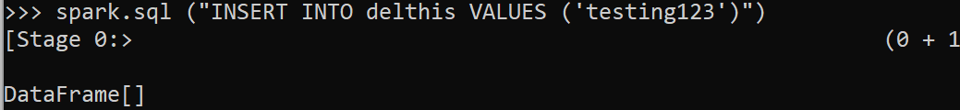
Creating a managed table
spark.sql (“CREATE TABLE delthis (name char (30)”)
spark.sql (“INSERT INTO delthis VALUES (‘testing123’)”)

Slide 38
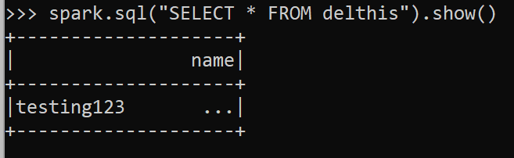
Validating
spark.sql (“SELECT * FROM delthis”).show ()

Slide 39
Two syntaxes for creating a managed table
Spark SQL syntax
spark.sql ("CREATE TABLE managed_us_delay_flights_tbl (date STRING, delay INT, distance INT, origin STRING, destination STRING)")
Empty table
csv_file = "departuredelays.csv"
schema = "date STRING, delay INT, distance INT, origin STRING, destination STRING"
flights_df = spark.read.csv (csv_file, schema=schema)
flights_df.write.saveAsTable ("managed_us_delay_flights_tbl")
Table with data

Slide 40
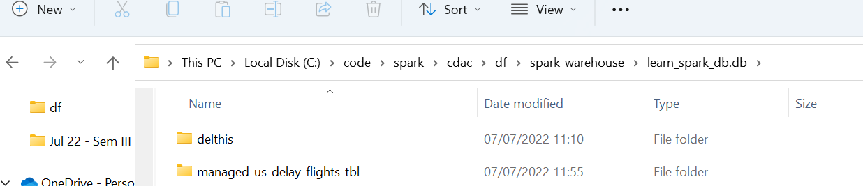
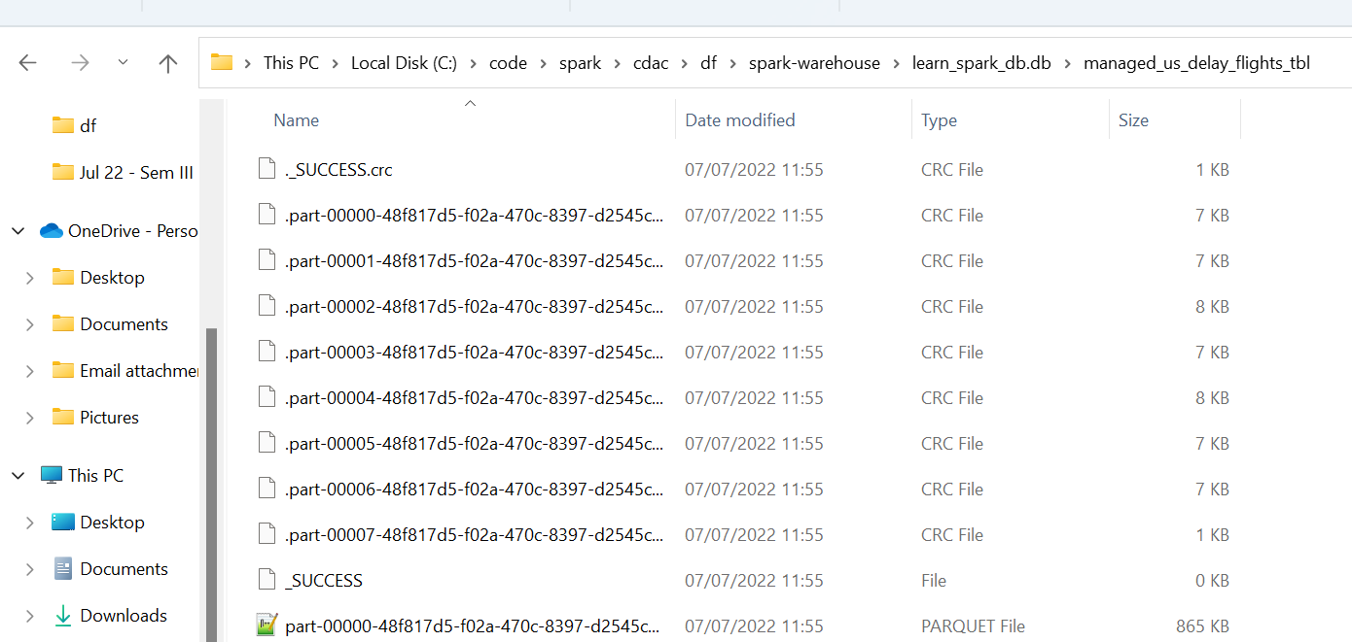
Result of table creation

Slide 41
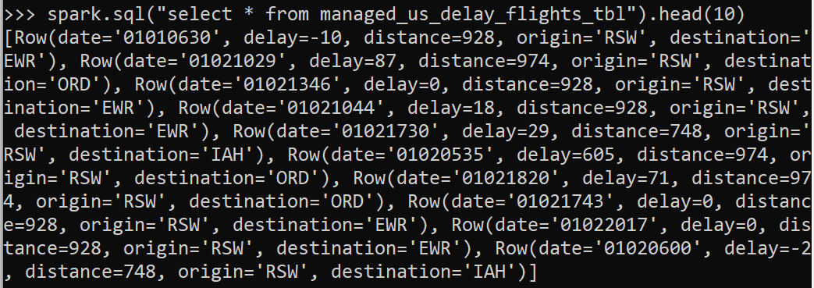
Test
spark.sql("select * from managed_us_delay_flights_tbl").head(10)

Slide 42
Creating an unmanaged table
spark.sql ("""CREATE TABLE us_delay_flights_tbl (date STRING, delay INT, distancec INT, origin STRING, destination STRING) USING csv OPTIONS (PATH 'departuredelays.csv')""")
We may get a warning that Hive does not support csv

Slide 43
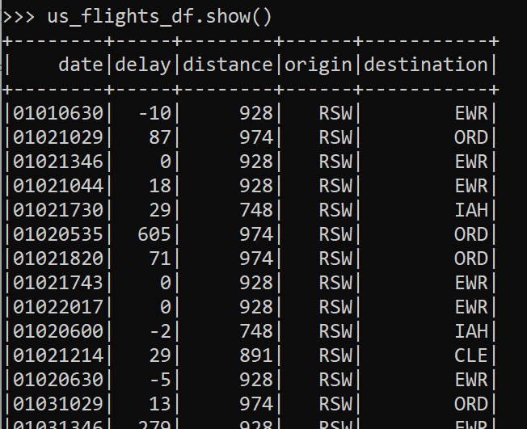
Reading a table into a dataframe
us_flights_df = spark.sql ("SELECT * FROM managed_us_delay_flights_tbl")
OR
us_flights_df = spark.table ("managed_us_delay_flights_tbl")
us_flights_df.show()

Slide 44
Why do this?
Often, data engineers build data pipelines as part of their regular data ingestion and ETL processes
They populate Spark SQL databases and tables with cleansed data for consumption by applications downstream
For example, here we have returned the data not from CSV file, but from a dataframe by doing this: CSV -> SQL -> dataframe
We have the flexibility to read into other file formats using Spark’s built-in data sources

Slide 45
Machine Learning using PySpark

Slide 46
PySpark Machine Learning Basics
Spark’s library for machine learning is called MLlib (Machine Learning library).
Main components of MLlib
DataFrame: This ML API uses DataFrame from Spark SQL as an ML dataset, which can hold a variety of data types. e.g., a DataFrame could have different columns storing text, feature vectors, true labels, and predictions.
Transformer: A Transformer is an algorithm that can transform one DataFrame into another DataFrame. e.g., an ML model is a Transformer that transforms a DataFrame with features into a DataFrame with predictions.
Estimator: An Estimator is an algorithm which can be fit on a DataFrame to produce a Transformer. e.g., a learning algorithm is an Estimator which trains on a DataFrame and produces a model
Pipeline: A Pipeline chains multiple Transformers and Estimators together to specify an ML workflow
Parameter: All Transformers and Estimators now share a common API for specifying parameters.

Slide 47
Basic code C:\code\spark\cdac\ml\1-ml.py
from pyspark.sql import SparkSession
spark = SparkSession.builder.appName ('lr_example').getOrCreate ()
from pyspark.ml.regression import LinearRegression
data = spark.read.csv ('Ecommerce_Customers.csv', inferSchema = True, header = True)
data.printSchema ()
data.show ()
data.head (1)

Slide 48
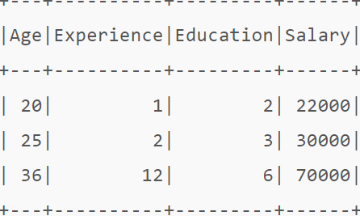
Features in Spark
Spark works to predict a target variable (i.e. dependent variable) with all the features (i.e. independent variables) grouped together into a list-like structure (called feature transformation)
We need to use a VectorAssembler for this
Example: Suppose we have the following features

Slide 49
Using VectorAssembler
Our goal: Combine the three numerical features (“Age”, “Experience”, “Education”) into a single vector column (let’s call it “features”)
VectorAssembler will have two parameters:
InputCols – list of features to combine into a single vector column
OutputCol – the new column that will contain the transformed vector
How to do it?
from pyspark.ml.feature import VectorAssembler
assembler = VectorAssembler(
inputCols=["Age", "Experience", "Education"],
outputCol="features")

Slide 50
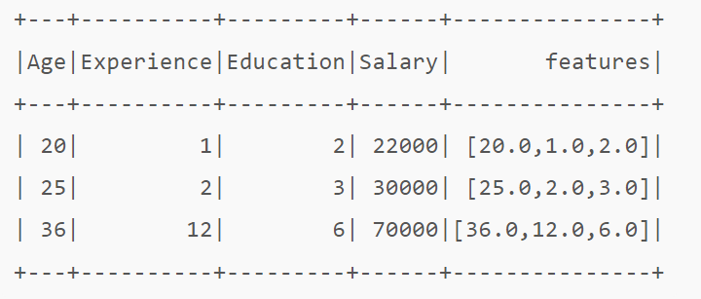
Result of using VectorAssembler
This DataFrame can now be used for training models available in Spark ML by passing “features” vector column as the input variable and “salary” as the target variable

Slide 51
VectorAssembler C:\code\spark\cdac\ml\2-ml.py (Output – Next slide)
from pyspark.sql import SparkSession
from pyspark.ml.regression import LinearRegression
from pyspark.ml.linalg import Vectors
from pyspark.ml.feature import VectorAssembler
spark = SparkSession.builder.appName ('lr_example').getOrCreate ()
data = spark.read.csv ('Ecommerce_Customers.csv', inferSchema = True, header = True)
assembler = VectorAssembler (inputCols = ['Avg Session Length', 'Time on App', 'Time on Website', 'Length of Membership'], outputCol = 'features')
output = assembler.transform (data)
output.printSchema ()
output.select ('features').show ()
print (output.head (1))

Slide 52
VectorAssembler output
[Row(Email='mstephenson@fernandez.com', Address='835 Frank TunnelWrightmouth, MI 82180-9605', Avatar='Violet', Avg Session Length=34.49726772511229, Time on App=12.65565114916675, Time on Website=39.57766801952616, Length of Membership=4.0826206329529615, Yearly Amount Spent=587.9510539684005, features=DenseVector([34.4973, 12.6557, 39.5777, 4.0826]))]

Slide 53
Display the Independent (Feature) and Dependent Variable Values C:\code\spark\cdac\ml\3-ml.py
from pyspark.sql import SparkSession
from pyspark.ml.regression import LinearRegression
from pyspark.ml.linalg import Vectors
from pyspark.ml.feature import VectorAssembler
spark = SparkSession.builder.appName ('lr_example').getOrCreate ()
data = spark.read.csv ('Ecommerce_Customers.csv', inferSchema = True, header = True)
assembler = VectorAssembler (inputCols = ['Avg Session Length', 'Time on App', 'Time on Website', 'Length of Membership'], outputCol = 'features')
output = assembler.transform (data)
final_data = output.select ('features', 'Yearly Amount Spent')
final_data.show ()

Slide 54
Display Training and Test Data C:\code\spark\cdac\ml\4-ml.py
from pyspark.sql import SparkSession
from pyspark.ml.regression import LinearRegression
from pyspark.ml.linalg import Vectors
from pyspark.ml.feature import VectorAssembler
spark = SparkSession.builder.appName ('lr_example').getOrCreate ()
data = spark.read.csv ('Ecommerce_Customers.csv', inferSchema = True, header = True)
assembler = VectorAssembler (inputCols = ['Avg Session Length', 'Time on App', 'Time on Website', 'Length of Membership'], outputCol = 'features')
output = assembler.transform (data)
final_data = output.select ('features', 'Yearly Amount Spent')
train_data, test_data = final_data.randomSplit ([0.7, 0.3])
train_data.describe ().show ()
test_data.describe ().show ()

Slide 55
Basic ML C:\code\spark\cdac\ml\5-ml.py
from pyspark.sql import SparkSession
from pyspark.ml.regression import LinearRegression
from pyspark.ml.linalg import Vectors
from pyspark.ml.feature import VectorAssembler
spark = SparkSession.builder.appName ('lr_example').getOrCreate ()
data = spark.read.csv ('Ecommerce_Customers.csv', inferSchema = True, header = True)
assembler = VectorAssembler (inputCols = ['Avg Session Length', 'Time on App', 'Time on Website', 'Length of Membership'], outputCol = 'features')
output = assembler.transform (data)
final_data = output.select ('features', 'Yearly Amount Spent')
train_data, test_data = final_data.randomSplit ([0.7, 0.3])
lr = LinearRegression (labelCol = 'Yearly Amount Spent')
lr_model = lr.fit (train_data)
test_results = lr_model.evaluate (test_data)
# See the difference between the actual and predicted values for the test data
test_results.residuals.show ()

Slide 56
Regression C:\code\spark\cdac\ml\6-ml.py (See next slide for interpretation)
from pyspark.sql import SparkSession
from pyspark.ml.regression import LinearRegression
from pyspark.ml.linalg import Vectors
from pyspark.ml.feature import VectorAssembler
spark = SparkSession.builder.appName ('lr_example').getOrCreate ()
data = spark.read.csv ('Ecommerce_Customers.csv', inferSchema = True, header = True)
assembler = VectorAssembler (inputCols = ['Avg Session Length', 'Time on App', 'Time on Website', 'Length of Membership'], outputCol = 'features')
output = assembler.transform (data)
final_data = output.select ('features', 'Yearly Amount Spent')
train_data, test_data = final_data.randomSplit ([0.7, 0.3])
lr = LinearRegression (labelCol = 'Yearly Amount Spent')
lr_model = lr.fit (train_data)
test_results = lr_model.evaluate (test_data)
# Calculate Root Mean Squared Error (Similar to Ordinary Least Squared Error)
print (test_results.rootMeanSquaredError)
# How good is the regression line? Calculate r squared: coefficient of determination
print (test_results.r2)
# Print the overall results
final_data.describe ().show ()

Slide 57
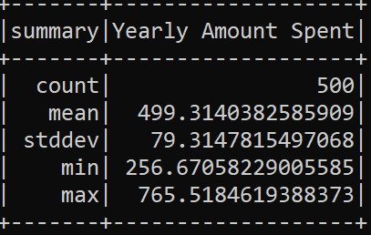
Regression Results
RMSE: 10.070715458937476
R squared: 0.9837736000803796
Overall results:
RMSE on its own is meaningless, but when we compare it with the overall results, we see that the average yearly amount spent is 499, SD is 79
So, an error of 10 is quite low as compared to it
Conclusion: Our regression model seems to be good
R squared is quite high: 98%, that is this model explains 98% of variations in the data – quite good!

Slide 58
Now let us predict the outcome
We will display the actual versus predicted values of the Yearly Amount Spent
We will use transform for this

Slide 59
Prediction using Regression Basic ML C:\code\spark\cdac\ml\7-ml.py
from pyspark.sql import SparkSession
from pyspark.ml.regression import LinearRegression
from pyspark.ml.linalg import Vectors
from pyspark.ml.feature import VectorAssembler
spark = SparkSession.builder.appName ('lr_example').getOrCreate ()
data = spark.read.csv ('Ecommerce_Customers.csv', inferSchema = True, header = True)
assembler = VectorAssembler (inputCols = ['Avg Session Length', 'Time on App', 'Time on Website', 'Length of Membership'], outputCol = 'features')
output = assembler.transform (data)
final_data = output.select ('features', 'Yearly Amount Spent')
train_data, test_data = final_data.randomSplit ([0.7, 0.3])
lr = LinearRegression (labelCol = 'Yearly Amount Spent')
lr_model = lr.fit (train_data)
from pyspark.sql import SparkSession
from pyspark.ml.regression import LinearRegression
from pyspark.ml.linalg import Vectors
from pyspark.ml.feature import VectorAssembler
spark = SparkSession.builder.appName ('lr_example').getOrCreate ()
data = spark.read.csv ('Ecommerce_Customers.csv', inferSchema = True, header = True)
assembler = VectorAssembler (inputCols = ['Avg Session Length', 'Time on App', 'Time on Website', 'Length of Membership'], outputCol = 'features')
output = assembler.transform (data)
final_data = output.select ('features', 'Yearly Amount Spent')
train_data, test_data = final_data.randomSplit ([0.7, 0.3])
lr = LinearRegression (labelCol = 'Yearly Amount Spent')
lr_model = lr.fit (train_data)
test_results = lr_model.transform (test_data)
test_results.show ()

Slide 60
Titanic Example: Predict if a passenger survived or not, Dataset: C:\code\spark\cdac\ml\train-example\titanic.csv

Slide 61
Load data and show the first 5 records C:\code\spark\cdac\ml\titanic-example\titanic-1.py
from pyspark.sql import SparkSession
spark = SparkSession.builder.appName('Titanic Data').getOrCreate()
df = spark.read.csv ('titanic.csv', inferSchema = True, header = True)
df.show (5)

Slide 62
Display basic information – Number of records, fields, schema C:\code\spark\cdac\ml\titanic-example\titanic-2.py
from pyspark.sql import SparkSession
spark = SparkSession.builder.appName('Titanic Data').getOrCreate()
df = spark.read.csv ('titanic.csv', inferSchema = True, header = True)
print ("Number of records in the file ... %d" % df.count ())
print (df.columns)
print (df.dtypes)
df.describe ()

Slide 63
Data Preparation and Feature Engineering
From the earlier output, all the columns seem to be of type string, which is incorrect
We need to cast the columns appropriately to solve this issue
We need not do this for all the columns, but only for the columns that we need for our modelling

Slide 64
Type casted columns C:\code\spark\cdac\ml\titanic-example\titanic-3.py
from pyspark.sql import SparkSession
from pyspark.sql.functions import col
spark = SparkSession.builder.appName('Titanic Data').getOrCreate()
df = spark.read.csv ('titanic.csv', inferSchema = True, header = True)
dataset = df.select(col('Survived').cast('float'),
col('Pclass').cast('float'),
col('Gender'),
col('Age').cast('float'),
col('Fare').cast('float'),
col('Embarked')
)
dataset.show()

Slide 65
Encoding Data
Spark ML library works only with numeric data
We have Gender and Embarked columns, which contain non-numeric data
We need to encode them (Similar to dummy variables)
For this, we can use a StringIndexer class

Slide 66
Encode Data C:\code\spark\cdac\ml\titanic-example\titanic-4.py
from pyspark.sql import SparkSession
from pyspark.ml.feature import StringIndexer
from pyspark.sql.functions import col
spark = SparkSession.builder.appName('Titanic Data').getOrCreate()
df = spark.read.csv ('titanic.csv', inferSchema = True, header = True)
dataset = df.select(col('Survived').cast('float'),
col('Pclass').cast('float'),
col('Gender'),
col('Age').cast('float'),
col('Fare').cast('float'),
col('Embarked')
)
dataset = StringIndexer(
inputCol='Gender',
outputCol='GenderEncoded',
handleInvalid='keep').fit(dataset).transform(dataset)
dataset = StringIndexer(
inputCol='Embarked',
outputCol='EmbarkedEncoded',
handleInvalid='keep').fit(dataset).transform(dataset)
dataset.show()

Slide 67
Results of Encoding Data
We have added two new columns: GenderEncoded and EmbarkedEncoded, that represent the respective original two columns in numeric format
We do not need the original two new columns, i.e. Gender and Embarked now, so we can drop them
We then rename the two _encoded columns, so that Gender_encoded is renamed as Gender and Embarked_encoded is renamed as Embarked

Slide 68
C:\code\spark\cdac\ml\titanic-example\titanic-5.py
from pyspark.sql import SparkSession
from pyspark.ml.feature import StringIndexer
from pyspark.sql.functions import col
spark = SparkSession.builder.appName('Titanic Data').getOrCreate()
df = spark.read.csv ('titanic.csv', inferSchema = True, header = True)
dataset = df.select(col('Survived').cast('float'),
col('Pclass').cast('float'),
col('Gender'),
col('Age').cast('float'),
col('Fare').cast('float'),
col('Embarked')
)
dataset = StringIndexer(
inputCol='Gender',
outputCol='GenderEncoded',
handleInvalid='keep').fit(dataset).transform(dataset)
dataset = StringIndexer(
inputCol='Embarked',
outputCol='EmbarkedEncoded',
handleInvalid='keep').fit(dataset).transform(dataset)
# Drop unnecessary columns
dataset = dataset.drop('Gender')
dataset = dataset.drop('Embarked')
datasetFinal = dataset.withColumnRenamed ("GenderEncoded", "Gender").withColumnRenamed ("EmbarkedEncoded", "Embarked")
datasetFinal.show()

Slide 69
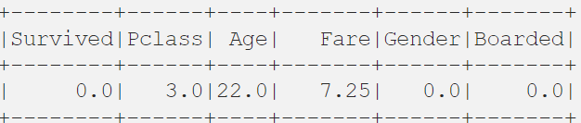
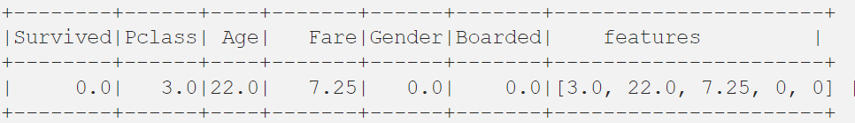
Creating Feature Column using VectorAssembler
Spark actually works to predict with a column with all the features smashed together into a list-like structure
Example: We need to predict Survived
We need to do this:

Slide 70
Feature Engineering C:\code\spark\cdac\ml\titanic-example\titanic-6.py
from pyspark.sql import SparkSession
from pyspark.ml.feature import StringIndexer
from pyspark.sql.functions import col
spark = SparkSession.builder.appName('Titanic Data').getOrCreate()
df = spark.read.csv ('titanic.csv', inferSchema = True, header = True)
dataset = df.select(col('Survived').cast('float'),
col('Pclass').cast('float'),
col('Gender'),
col('Age').cast('float'),
col('Fare').cast('float'),
col('Embarked')
)
dataset = StringIndexer(
inputCol='Gender',
outputCol='GenderEncoded',
handleInvalid='keep').fit(dataset).transform(dataset)
dataset = StringIndexer(
inputCol='Embarked',
outputCol='EmbarkedEncoded',
handleInvalid='keep').fit(dataset).transform(dataset)
# Drop unnecessary columns
dataset = dataset.drop('Gender')
dataset = dataset.drop('Embarked')
datasetFinal = dataset.withColumnRenamed ("GenderEncoded", "Gender").withColumnRenamed ("EmbarkedEncoded", "Embarked")
# Remove nulls, else we will have problems later
datasetFinal = datasetFinal.replace('?', None).dropna(how='any')
# datasetFinal.show ()
required_features = ['Pclass',
'Age',
'Fare',
'Gender',
'Embarked'
]
from pyspark.ml.feature import VectorAssembler
assembler = VectorAssembler(inputCols=required_features, outputCol='features')
transformed_data = assembler.transform(datasetFinal)
transformed_data.show ()

Slide 71
Modeling
Split the dataset into training and testing datasets
Build and fit an ML model to our dataset to predict the “Survived” columns with all the other ones
Fit the model, which gives us a transformer
Predict using the test dataset

Slide 72
Model C:\code\spark\cdac\ml\titanic-example\titanic-7.py
from pyspark.sql import SparkSession
from pyspark.ml.feature import StringIndexer
from pyspark.sql.functions import col
from pyspark.ml.feature import VectorAssembler
from pyspark.ml.classification import RandomForestClassifier
spark = SparkSession.builder.appName('Titanic Data').getOrCreate()
df = spark.read.csv ('titanic.csv', inferSchema = True, header = True)
dataset = df.select(col('Survived').cast('float'),
col('Pclass').cast('float'),
col('Gender'),
col('Age').cast('float'),
col('Fare').cast('float'),
col('Embarked')
)
dataset = StringIndexer(
inputCol='Gender',
outputCol='GenderEncoded',
handleInvalid='keep').fit(dataset).transform(dataset)
dataset = StringIndexer(
inputCol='Embarked',
outputCol='EmbarkedEncoded',
handleInvalid='keep').fit(dataset).transform(dataset)
# Drop unnecessary columns
dataset = dataset.drop('Gender')
dataset = dataset.drop('Embarked')
datasetFinal = dataset.withColumnRenamed ("GenderEncoded", "Gender").withColumnRenamed ("EmbarkedEncoded", "Embarked")
# Remove nulls, else we will have problems later
datasetFinal = datasetFinal.replace('?', None).dropna(how='any')
# datasetFinal.show ()
required_features = ['Pclass',
'Age',
'Fare',
'Gender',
'Embarked'
]
assembler = VectorAssembler(inputCols=required_features, outputCol='features')
transformed_data = assembler.transform(datasetFinal)
(training_data, test_data) = transformed_data.randomSplit([0.8,0.2])
rf = RandomForestClassifier(labelCol='Survived',
featuresCol='features',
maxDepth=5)
model = rf.fit(training_data)
predictions = model.transform(test_data).show ()

Slide 73
Evaluate the Model
Determine accuracy

Slide 74
Accuracy C:\code\spark\cdac\ml\titanic-example\titanic-8.py
from pyspark.sql import SparkSession
from pyspark.ml.feature import StringIndexer
from pyspark.sql.functions import col
from pyspark.ml.feature import VectorAssembler
from pyspark.ml.classification import RandomForestClassifier
from pyspark.ml.evaluation import MulticlassClassificationEvaluator
spark = SparkSession.builder.appName('Titanic Data').getOrCreate()
df = spark.read.csv ('titanic.csv', inferSchema = True, header = True)
dataset = df.select(col('Survived').cast('float'),
col('Pclass').cast('float'),
col('Gender'),
col('Age').cast('float'),
col('Fare').cast('float'),
col('Embarked')
)
dataset = StringIndexer(
inputCol='Gender',
outputCol='GenderEncoded',
handleInvalid='keep').fit(dataset).transform(dataset)
dataset = StringIndexer(
inputCol='Embarked',
outputCol='EmbarkedEncoded',
handleInvalid='keep').fit(dataset).transform(dataset)
# Drop unnecessary columns
dataset = dataset.drop('Gender')
dataset = dataset.drop('Embarked')
datasetFinal = dataset.withColumnRenamed ("GenderEncoded", "Gender").withColumnRenamed ("EmbarkedEncoded", "Embarked")
# Remove nulls, else we will have problems later
datasetFinal = datasetFinal.replace('?', None).dropna(how='any')
# datasetFinal.show ()
required_features = ['Pclass',
'Age',
'Fare',
'Gender',
'Embarked'
]
assembler = VectorAssembler(inputCols=required_features, outputCol='features')
transformed_data = assembler.transform(datasetFinal)
(training_data, test_data) = transformed_data.randomSplit([0.8,0.2])
rf = RandomForestClassifier(labelCol='Survived',
featuresCol='features',
maxDepth=5)
model = rf.fit(training_data)
predictions = model.transform(test_data)
evaluator = MulticlassClassificationEvaluator(
labelCol='Survived',
predictionCol='prediction',
metricName='accuracy')
accuracy = evaluator.evaluate (predictions)
print ("Accuracy: %f" % accuracy)

Slide 75
Linear Regression Exercise

Slide 76
Shipping Company - Cruises
Use C:\code\spark\cdac\ml\shipping-example\ cruise_ship_info.csv
The file contains information about various cruises
We need to predict the crew members needed for future cruises by using a regression model
In other words, decide the features that will be useful to predict the value in the Crew column
Suppose we have been told that a particular Cruise_lines will use different acceptable crew counts – so it is most likely a factor to consider in the analysis

Slide 77
Just print basic information C:\code\spark\cdac\ml\shipping-example\shipping-1.py
from pyspark.sql import SparkSession
spark = SparkSession.builder.appName ('Cruise').getOrCreate ()
df = spark.read.csv ('cruise_ship_info.csv', inferSchema = True, header = True)
for ship in df.head (5):
print (ship)
print ('\n')

Slide 78
Cruise lines – Dummy Variable
We have been told that this is an important field
We need to convert this string field into an integer (to categorize it and use it in the feature analysis further) – Dummy variable
So, let us first display all the cruise line values along with the number of cruises they have undertaken till now
Then let us convert the variable into an integer category (i.e. Dummy variable) and verify

Slide 79
Dummy variable creation C:\code\spark\cdac\ml\shipping-example\shipping-2.py
from pyspark.sql import SparkSession
spark = SparkSession.builder.appName ('Cruise').getOrCreate ()
df = spark.read.csv ('cruise_ship_info.csv', inferSchema = True, header = True)
df.groupBy ('Cruise_line').count ().show ()
# Convert the Cruise_line from a String type to an integer to indicate the category
# of the Cruise_line
from pyspark.ml.feature import StringIndexer
indexer = StringIndexer (inputCol = 'Cruise_line', outputCol = 'cruise_cat')
indexed = indexer.fit (df).transform (df)
print (indexed.head (1))

Slide 80
Feature engineering – Transform step C:\code\spark\cdac\ml\shipping-example\shipping-3.py
from pyspark.sql import SparkSession
spark = SparkSession.builder.appName ('Cruise').getOrCreate ()
df = spark.read.csv ('cruise_ship_info.csv', inferSchema = True, header = True)
# df.groupBy ('Cruise_line').count ().show ()
# Convert the Cruise_line from a String type to an integer to indicate the category
# of the Cruise_line
from pyspark.ml.feature import StringIndexer
indexer = StringIndexer (inputCol = 'Cruise_line', outputCol = 'cruise_cat')
indexed = indexer.fit (df).transform (df)
# print (indexed.head (1))
from pyspark.ml.linalg import Vectors
from pyspark.ml.feature import VectorAssembler
assembler = VectorAssembler (inputCols = ['Age', 'Tonnage', 'passengers', 'length', 'cabins', 'passenger_density', 'cruise_cat'], outputCol = 'features')
output = assembler.transform (indexed)
output.select ('features', 'crew').show ()

Slide 81
Feature engineering – Transform step C:\code\spark\cdac\ml\shipping-example\shipping-3.py
from pyspark.sql import SparkSession
spark = SparkSession.builder.appName ('Cruise').getOrCreate ()
df = spark.read.csv ('cruise_ship_info.csv', inferSchema = True, header = True)
# df.groupBy ('Cruise_line').count ().show ()
# Convert the Cruise_line from a String type to an integer to indicate the category
# of the Cruise_line
from pyspark.ml.feature import StringIndexer
indexer = StringIndexer (inputCol = 'Cruise_line', outputCol = 'cruise_cat')
indexed = indexer.fit (df).transform (df)
# print (indexed.head (1))
from pyspark.ml.linalg import Vectors
from pyspark.ml.feature import VectorAssembler
assembler = VectorAssembler (inputCols = ['Age', 'Tonnage', 'passengers', 'length', 'cabins', 'passenger_density', 'cruise_cat'], outputCol = 'features')
output = assembler.transform (indexed)
output.select ('features', 'crew').show ()

Slide 82
Training and Testing Data Setup C:\code\spark\cdac\ml\shipping-example\shipping-4.py
from pyspark.sql import SparkSession
spark = SparkSession.builder.appName ('Cruise').getOrCreate ()
df = spark.read.csv ('cruise_ship_info.csv', inferSchema = True, header = True)
# df.groupBy ('Cruise_line').count ().show ()
# Convert the Cruise_line from a String type to an integer to indicate the category
# of the Cruise_line
from pyspark.ml.feature import StringIndexer
indexer = StringIndexer (inputCol = 'Cruise_line', outputCol = 'cruise_cat')
indexed = indexer.fit (df).transform (df)
# print (indexed.head (1))
from pyspark.ml.linalg import Vectors
from pyspark.ml.feature import VectorAssembler
assembler = VectorAssembler (inputCols = ['Age', 'Tonnage', 'passengers', 'length', 'cabins', 'passenger_density', 'cruise_cat'], outputCol = 'features')
output = assembler.transform (indexed)
# output.select ('features', 'crew').show ()
final_data = output.select (['features', 'crew'])
train_data, test_data = final_data.randomSplit ([0.7, 0.3])
train_data.describe ().show ()
test_data.describe ().show ()

Slide 83
Check model
Display RMS
Display training data statistics

Slide 84
Model correctness checking C:\code\spark\cdac\ml\shipping-example\shipping-5.py
from pyspark.sql import SparkSession
spark = SparkSession.builder.appName ('Cruise').getOrCreate ()
df = spark.read.csv ('cruise_ship_info.csv', inferSchema = True, header = True)
# df.groupBy ('Cruise_line').count ().show ()
# Convert the Cruise_line from a String type to an integer to indicate the category
# of the Cruise_line
from pyspark.ml.feature import StringIndexer
indexer = StringIndexer (inputCol = 'Cruise_line', outputCol = 'cruise_cat')
indexed = indexer.fit (df).transform (df)
# print (indexed.head (1))
from pyspark.ml.linalg import Vectors
from pyspark.ml.feature import VectorAssembler
assembler = VectorAssembler (inputCols = ['Age', 'Tonnage', 'passengers', 'length', 'cabins', 'passenger_density', 'cruise_cat'], outputCol = 'features')
output = assembler.transform (indexed)
# output.select ('features', 'crew').show ()
final_data = output.select (['features', 'crew'])
train_data, test_data = final_data.randomSplit ([0.7, 0.3])
# train_data.describe ().show ()
# test_data.describe ().show ()
from pyspark.ml.regression import LinearRegression
ship_lr = LinearRegression (labelCol = 'crew')
trained_ship_model = ship_lr.fit (train_data)
ship_results = trained_ship_model.evaluate (test_data)
print ("RMS = %f" % ship_results.rootMeanSquaredError)
train_data.describe ().show ()

Slide 85
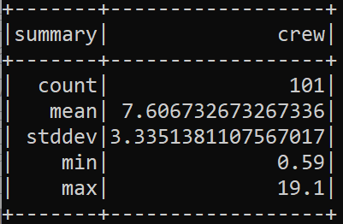
Regression Results
RMSE: 0.9667
R squared: 0.939704
Overall results:
RMSE on its own is meaningless, but when we compare it with the overall results, we see that the average crew size is 7.60, SD is 3.33
So, an error of 0.9667 is quite low as compared to it
Conclusion: Our regression model seems to be good
R squared is quite high: 93%, that is this model explains 93% of variations in the data – quite good!

Slide 86
Fitting Model for making Prediction C:\code\spark\cdac\ml\shipping-example\shipping-6.py
from pyspark.sql import SparkSession
spark = SparkSession.builder.appName ('Cruise').getOrCreate ()
df = spark.read.csv ('cruise_ship_info.csv', inferSchema = True, header = True)
# df.groupBy ('Cruise_line').count ().show ()
# Convert the Cruise_line from a String type to an integer to indicate the category
# of the Cruise_line
from pyspark.ml.feature import StringIndexer
indexer = StringIndexer (inputCol = 'Cruise_line', outputCol = 'cruise_cat')
indexed = indexer.fit (df).transform (df)
# print (indexed.head (1))
from pyspark.ml.linalg import Vectors
from pyspark.ml.feature import VectorAssembler
assembler = VectorAssembler (inputCols = ['Age', 'Tonnage', 'passengers', 'length', 'cabins', 'passenger_density', 'cruise_cat'], outputCol = 'features')
output = assembler.transform (indexed)
# output.select ('features', 'crew').show ()
final_data = output.select (['features', 'crew'])
train_data, test_data = final_data.randomSplit ([0.7, 0.3])
# train_data.describe ().show ()
# test_data.describe ().show ()
from pyspark.ml.regression import LinearRegression
ship_lr = LinearRegression (labelCol = 'crew')
trained_ship_model = ship_lr.fit (train_data)
#ship_results = trained_ship_model.evaluate (test_data)
# Calculate Root Mean Squared Error (Similar to Ordinary Least Squared Error)
#print ("RMS = %f" % ship_results.rootMeanSquaredError)
# How good is the regression line? Calculate r squared: coefficient of determination
#print ("R squared = %f" % ship_results.r2)
#train_data.describe ().show ()
test_results = trained_ship_model.transform (test_data)
test_results.show ()

Slide 87
Correlations
We can use correlations to check the dependence of one column on another
Example: Does number of passengers impact crew size, or does number of cabins impact crew size?
More passengers more crew members?
More cabins more crew members?

Slide 88
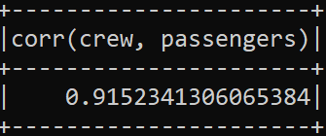
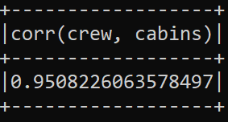
Correlation C:\code\spark\cdac\ml\shipping-example\shipping-6.py
from pyspark.sql import SparkSession
spark = SparkSession.builder.appName ('Cruise').getOrCreate ()
df = spark.read.csv ('cruise_ship_info.csv', inferSchema = True, header = True)
from pyspark.sql.functions import corr
df.select (corr ('crew', 'passengers')).show ()
df.select (corr ('crew', 'cabins')).show ()

Slide 89
Correlations interpretation
Yes, both correlations are very high

